Slide 1
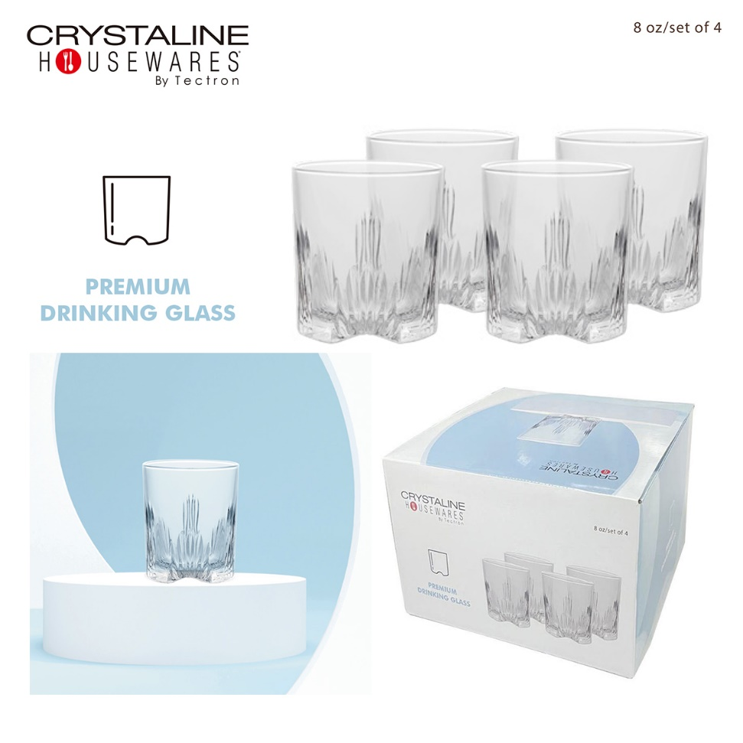
8 OZ SET OF 4 PREMIUM DRINKING GLASS
Suitable for everyday use and any occasions. They can hold hot and cold drinks.
Features:
8 Ounces
4 pcs set
Clear
Dishwasher safe
3.5” tall & 3.25” Diameter
Made in Italy
LINK FOR REFERENCE ONLY:
https://www.target.com/p/spiegelau-perfect-serve-double-old-fashioned-glasses-set-of-4-lowball-cocktail-glasses-crystal-dishwasher-safe-cocktail-glass-gift-set-13-oz/-/A-85954622?sid=&TCID=PDS-23939115273&gclsrc=aw.ds&gad_source=1&gad_campaignid=23944303391&gclid=Cj0KCQjw39zSBhDhARIsANammDtQS9oIIGDXjUh4RH5lFGz-y2GHqpEbaZv0v1ayNJ2kOeh1LNmD3BQaAtCMEALw_wcB
ITEM # | CASE PACK | UPC CODE | CASES/ PALLET | AVAILABLE | PRICE
HW GL4 | 6 SETS | 633040 206004 | 96 CASES | 3000 SETS OF 4 GLASSES | $6.95 set

